Slide 1


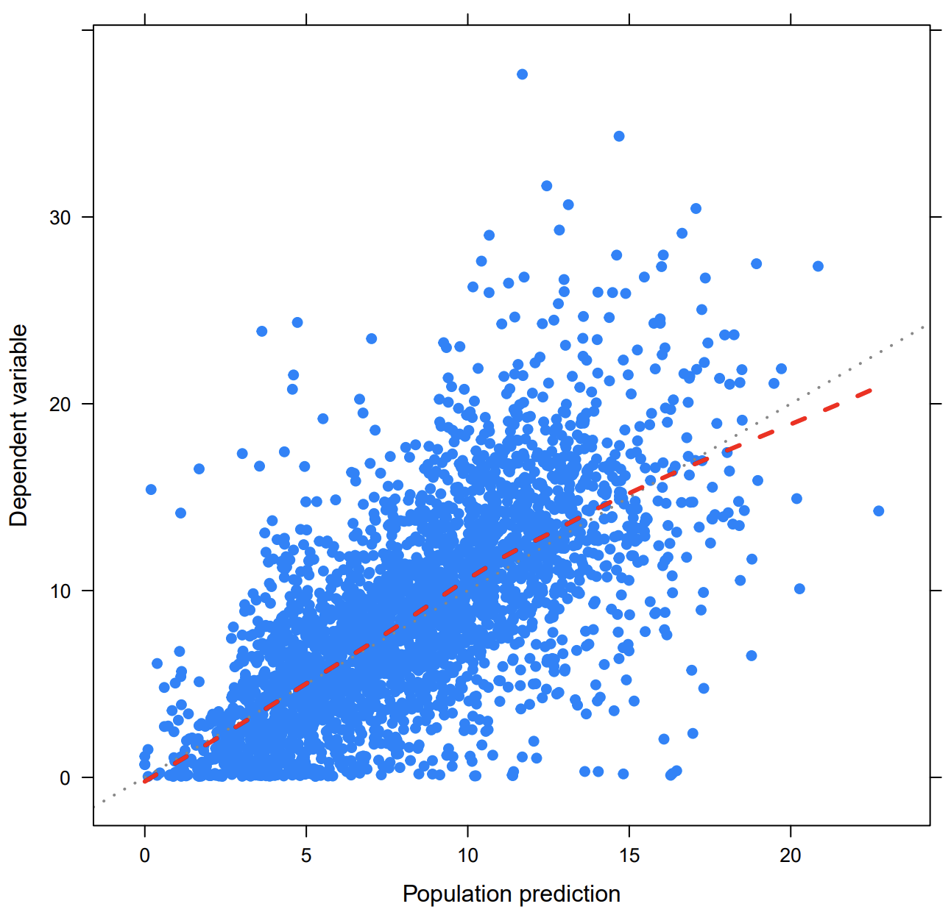
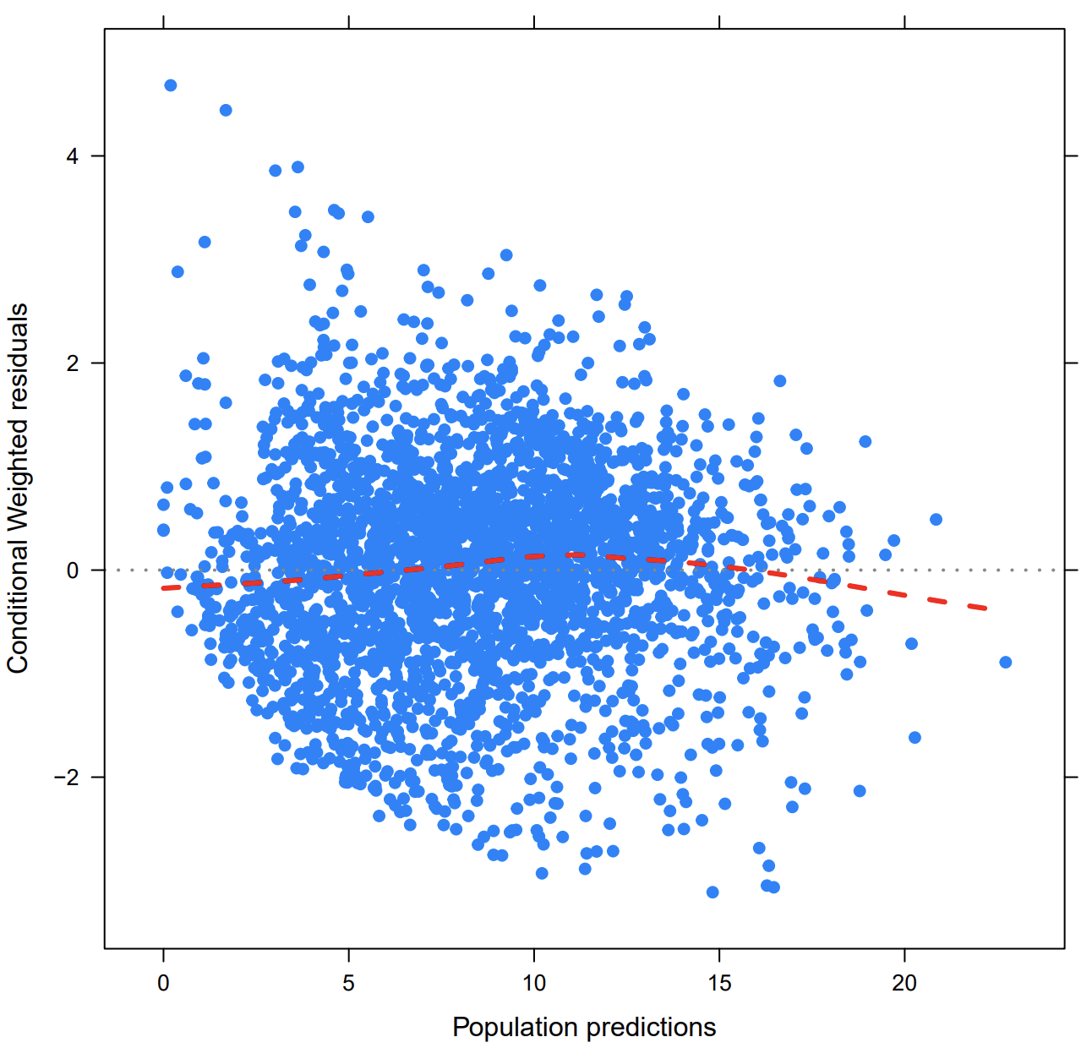
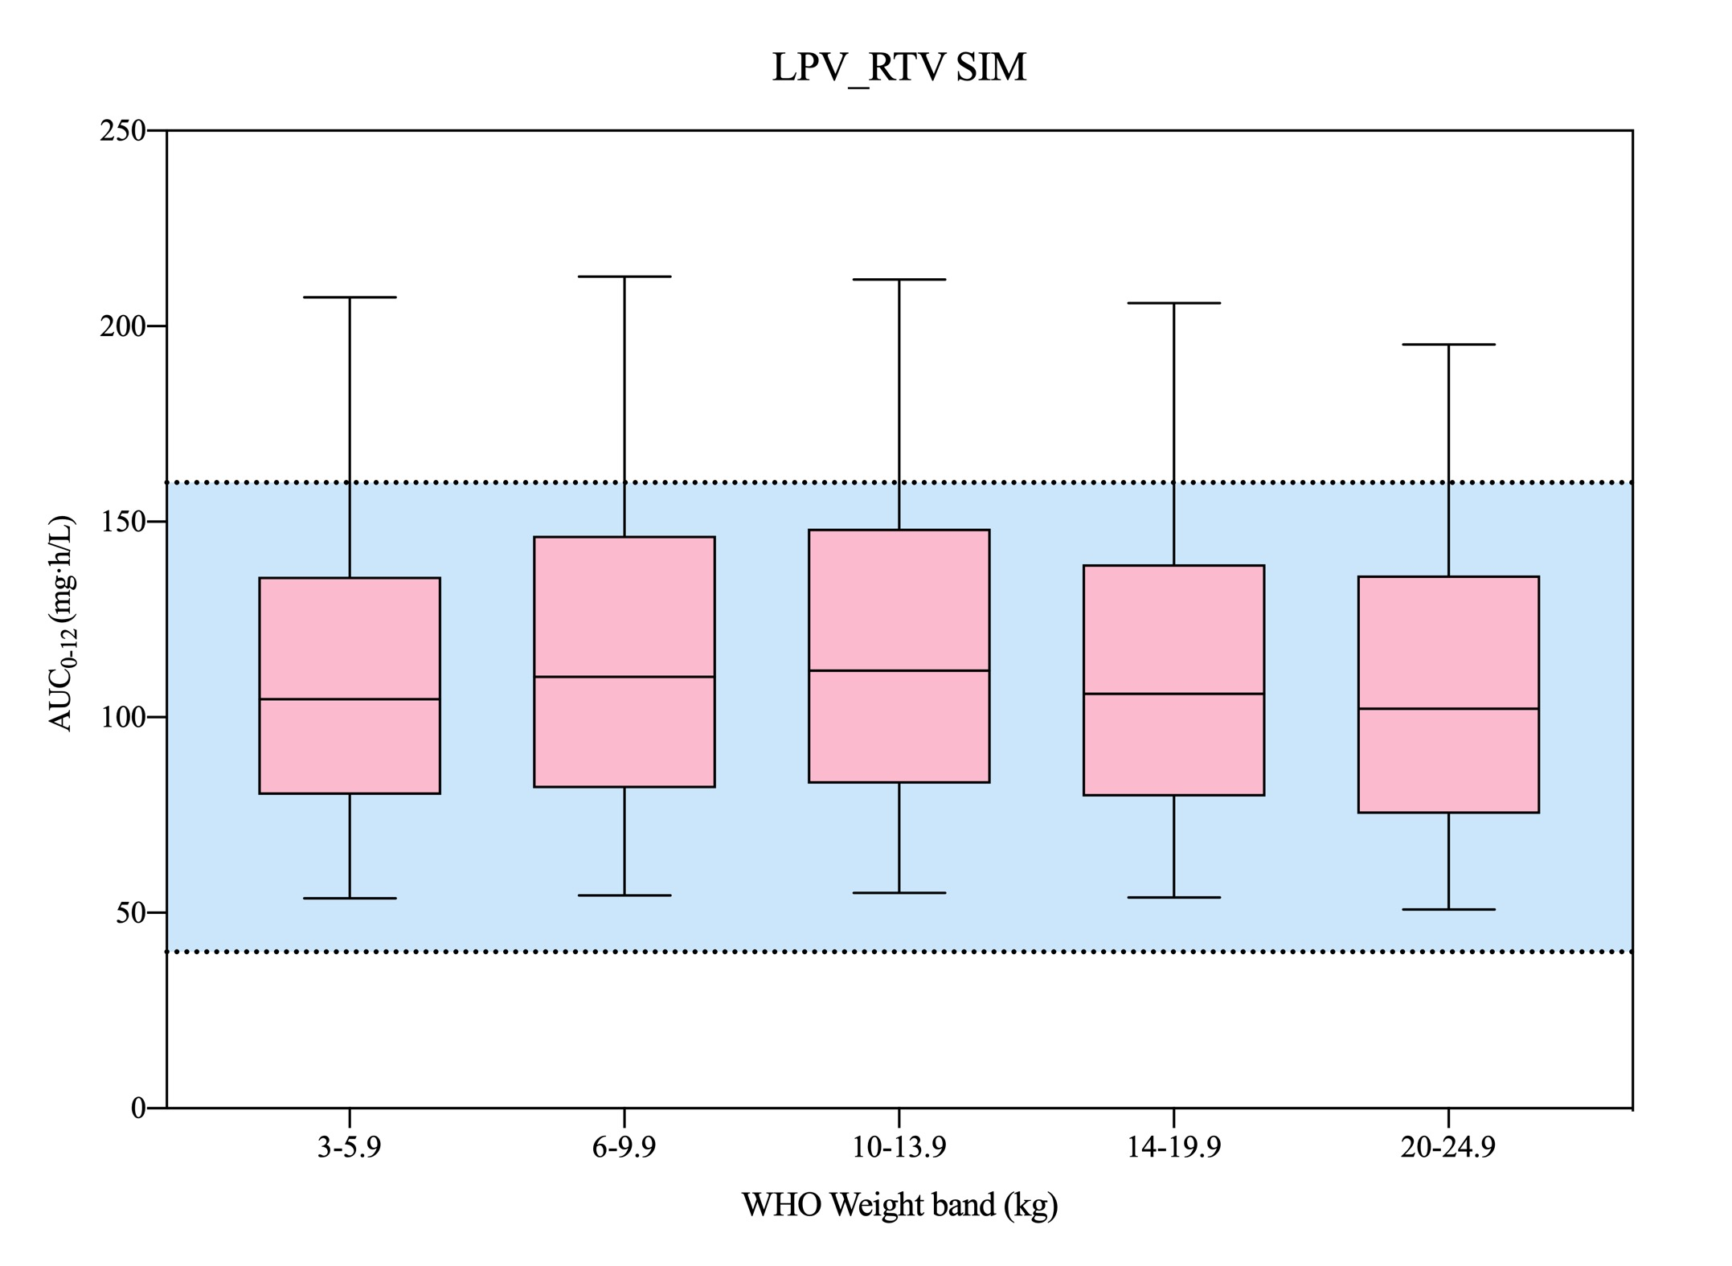













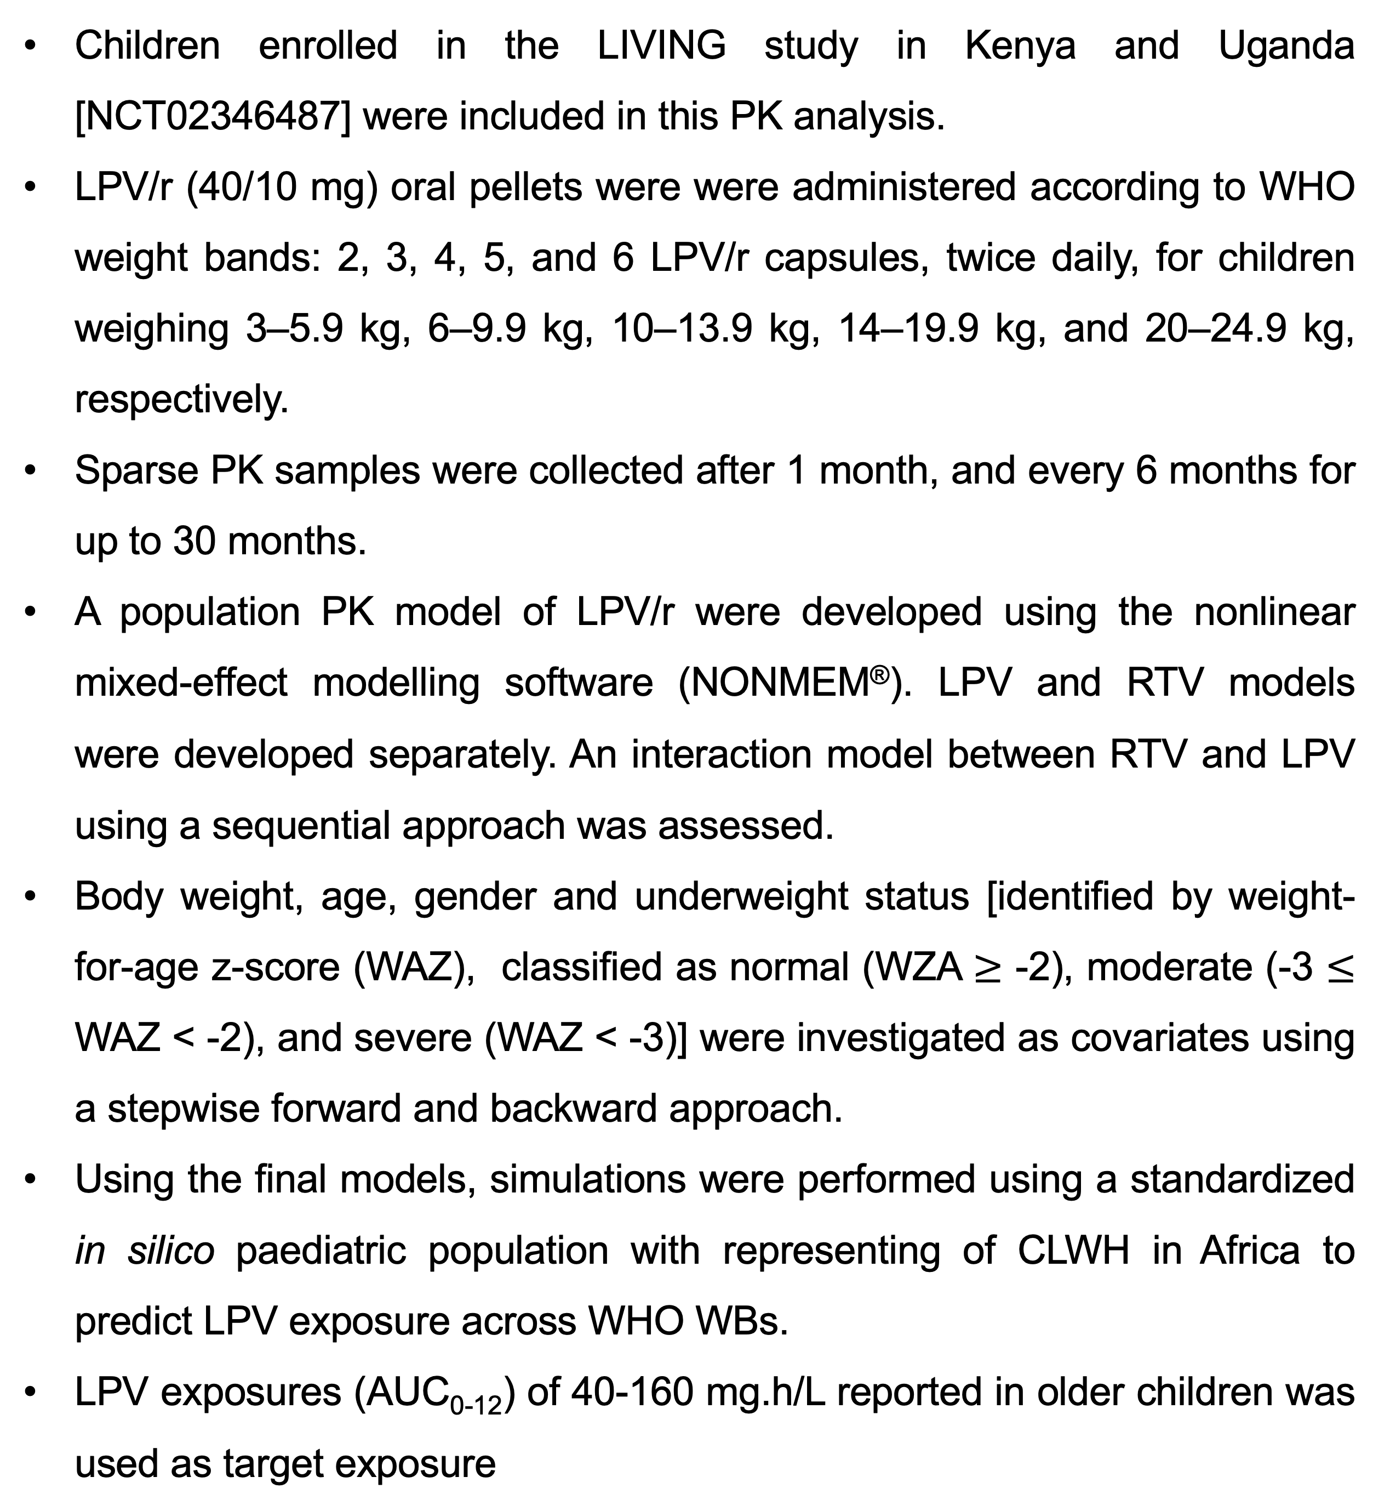
Population Pharmacokinetic analysis of lopinavir in children with HIV
in Africa receiving the pediatric lopinavir/ritonavir pellets formulation
Suthunya Chupradit¹, Dalton C. Wamalwa³, Elizabeth Maleche-Obimbo³, Adeodata R. Kekitiinwa⁴, Juliet Mwanga-Amumpaire⁵, Elizabeth A. Bukusi⁶, Winstone M. Nyandiko⁷, Joseph K. Mbuthia⁸, Alistair Swanson⁹ and DNDi Clinical Team⁹,
Tim R. Cressey^{10,11}, Baralee Punyawudho¹, Victor Musiime² for the LIVING Study Team
¹Department of Pharmaceutical Care, Faculty of Pharmacy, Chiang Mai University, Chiang Mai, Thailand; ²Joint Clinical Research Centre, Kampala, Uganda; ³Department of Paediatrics and Child Health, University of Nairobi, Nairobi, Kenya; ⁴Baylor College of Medicine Children’s Foundation, Kampala, Uganda; ⁵Epicentre, Mbarara, Uganda; ⁶Centre for Microbiology Research, Kenya Medical Research Institute, Kisumu, Kenya; ⁷Department of Child Health and Paediatrics - Moi University, AMPATH and Moi Teaching and Referral Hospital, Eldoret, Kenya; ⁸Gertrude’s Children’s Hospital, Nairobi, Kenya; ⁹Drugs for Neglected Diseases Initiative (Switzerland, Kenya and USA); ¹⁰AMS/IRD Collaboration, Faculty of Associated Medical Sciences, Chiang Mai University, Chiang Mai, Thailand; ¹¹Department of Molecular & Clinical Pharmacology, University of Liverpool, UK.
BACKGROUND & OBJECTIVE
Table 1. Baseline Demographic & Clinical Characteristics
Lopinavir/ritonavir (LPV/r) is widely used for the treatment of children living with HIV (CLWH) younger than 3 years of age.
LPV/r (40/10mg) oral pellets (‘mini-melt’ tablets, Cipla Ltd, India) was the first solid formulation for young children approved by the US Food and Drug Administration.
We describe the pharmacokinetic (PK) of LPV/r in African children receiving LPV/r pellets twice daily (BID) according to the World Health Organization (WHO) weight bands dosing.
Characteristics | Values
Number of subjects | 514
Gender, n (%) | Male: 248 (48%) Female: 266 (52%)
Age, yrs., mean ± SD | 3.28 ± 2.01 (0.3-12.4)
Body weight, kg, mean ± SD | 12.56 ± 3.97 (4.6-25)
Underweight status
Normal, n (%) | 374 (73)
Moderate underweight, n (%) | 88 (17)
Severe underweight, n (%) | 45 (9)
Table 2. Parameter estimates of the final population pharmacokinetic model of lopinavir
Parameter | NONMEM results
 | Estimated value | 2.5th | 97.5th
CL/F (L/h/13.6kg) | 5.70 | 5.38 | 6.02
V/F (L/13.6kg) | 29.90 | 27.23 | 32.57
Ka (/h) | 0.50 | 0.40 | 0.60
T_{LAG} (h) | 0.46 | 0.39 | 0.53
IIV_{CL}, %CV | 14.60 | 10.86 | 17.61
IIV_{V}, %CV | 31.90 | 24.14 | 38.17
IIV_{KA}, %CV | 88.40 | 66.85 | 105.70
IOV_{F}, %CV | 19.90 | 15.31 | 23.57
E_{max} | 0.9 Fix | - | -
IC₅₀ (mg/L) | 0.049 | 0.044 | 0.054
RUV
Proportional (%) | 26.20 | 21.05 | 30.61
Additive (mg/L) | 3.18 | 2.16 | 4.20
METHODS
Children enrolled in the LIVING study in Kenya and Uganda [NCT02346487] were included in this PK analysis.
LPV/r (40/10 mg) oral pellets were were administered according to WHO weight bands: 2, 3, 4, 5, and 6 LPV/r capsules, twice daily, for children weighing 3–5.9 kg, 6–9.9 kg, 10–13.9 kg, 14–19.9 kg, and 20–24.9 kg, respectively.
Sparse PK samples were collected after 1 month, and every 6 months for up to 30 months.
A population PK model of LPV/r were developed using the nonlinear mixed-effect modelling software (NONMEM®). LPV and RTV models were developed separately. An interaction model between RTV and LPV using a sequential approach was assessed.
Body weight, age, gender and underweight status [identified by weight-for-age z-score (WAZ), classified as normal (WZA $≥$ -2), moderate (-3 $≤$ WAZ < -2), and severe (WAZ < -3)] were investigated as covariates using a stepwise forward and backward approach.
Using the final models, simulations were performed using a standardized in silico paediatric population with representing of CLWH in Africa to predict LPV exposure across WHO WBs.
LPV exposures (AUC₀₋₁₂) of 40-160 mg.h/L reported in older children was used as target exposure
Parameter estimates are scaled to typical patient at 13.6 kg. NONMEM, nonlinear mixed effects modeling; CL/F, apparent oral clearance; V/F, apparent volume of distribution; Ka, absorption rate constant; T_{LAG}, absorption lag time; F, bioavailability; IIV, interindividual variability, IOV, inter-occasion variability; %CV, percent coefficient variation, RUV, residual variability. Emax is the maximum inhibitory effect of RTV on LPV CL/F and EC50 is the RTV concentration to reach 50% of the Emax and CRTV is the concentration of RTV.
Figure 1 Goodness-of-fit (GOF) plots of the final lopinavir pharmacokinetic model
Figure 2 Box and Whisker Plot of LPV exposure (AUC₀₋₁₂) per WHO weight-bands dosing (pink). Target AUC_{0–12} (40 to 160 mg.h/L) (shaded area).
RESULTS
CONCLUSIONS
LPV and RTV concentrations were best described a one-compartment model with first order absorption (with lag-time) and elimination.
The dynamic influence of RTV concentrations on LPV CL/F was modeled using an Emax model with direct inhibition.
Body weight influenced LPV and RTV CL/F and V/F and was allometrically scaled, but the inclusion of maturational changes as a function of age did not improve the model fit.
Model simulations predicted that target LPV exposures were achieved in African children with this solid formulation across the WHO weight bands (Figure 2).
LPV drug exposures in African children weighing 3.0 to 24.9 kg using the generic LPV/r pellets dosed per WHO weight bands were comparable to those reported with the original liquid and tablet formulations.
ACKNOWLEDGEMENTS
We are grateful to all participants of the Living study, study staff and partner. This work was supported by drugs for neglected diseases initiative (DNDi) Switzerland, Kenya and USA.
Presentation of this poster presentation and participation in the 30th PAGE meeting was made possible thanks to a PAGE scholarship. Financial support was based on predefined criteria and the merit of each application was assessed by a selection committee.
REFERENCES
World Health Organization. Consolidated guidelines on the use of antiretroviral drugs for treating and preventing HIV infection: recommendation for a public health approach. 2nd. World Health Organization; Geneva, Switzerland: 2016.
Fact Sheet on Lopinavir And Ritonavir (LPV/R) Oral Pellets. Interagency Task Team. September 2015.
Dayneka NL, Garg V, Jusko WJ. Comparison of four basic models of indirect pharmacodynamic responses. J Pharmacokinet Biopharm. 1993;21:457–78.
Pinto JA, Capparelli EV, Warshaw M, et al. A Phase II/III Trial of Lopinavir/Ritonavir Dosed According to the Who Pediatric Weight Band Dosing Guidelines. Pediatr Infect Dis J. 2018; 37(2): e29–e35.
Thanks to the children’s caregivers & study site staff

