Slide 1
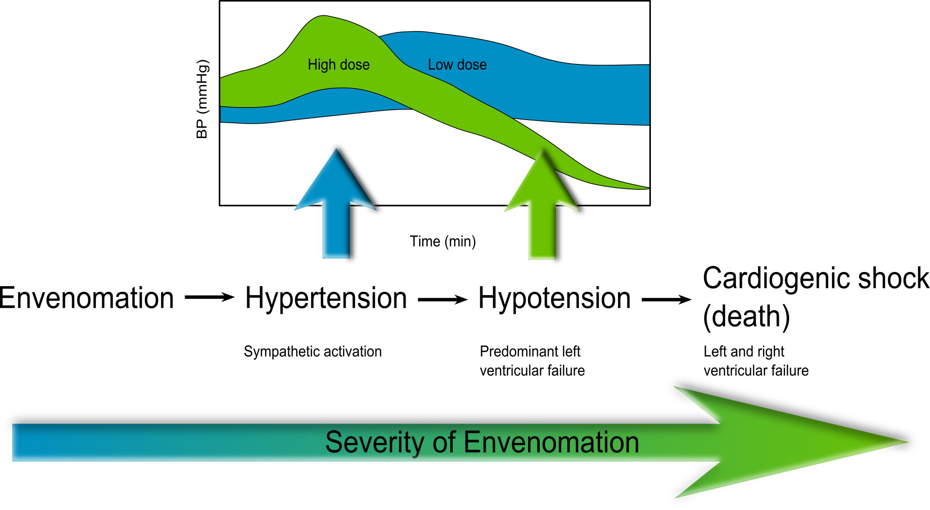
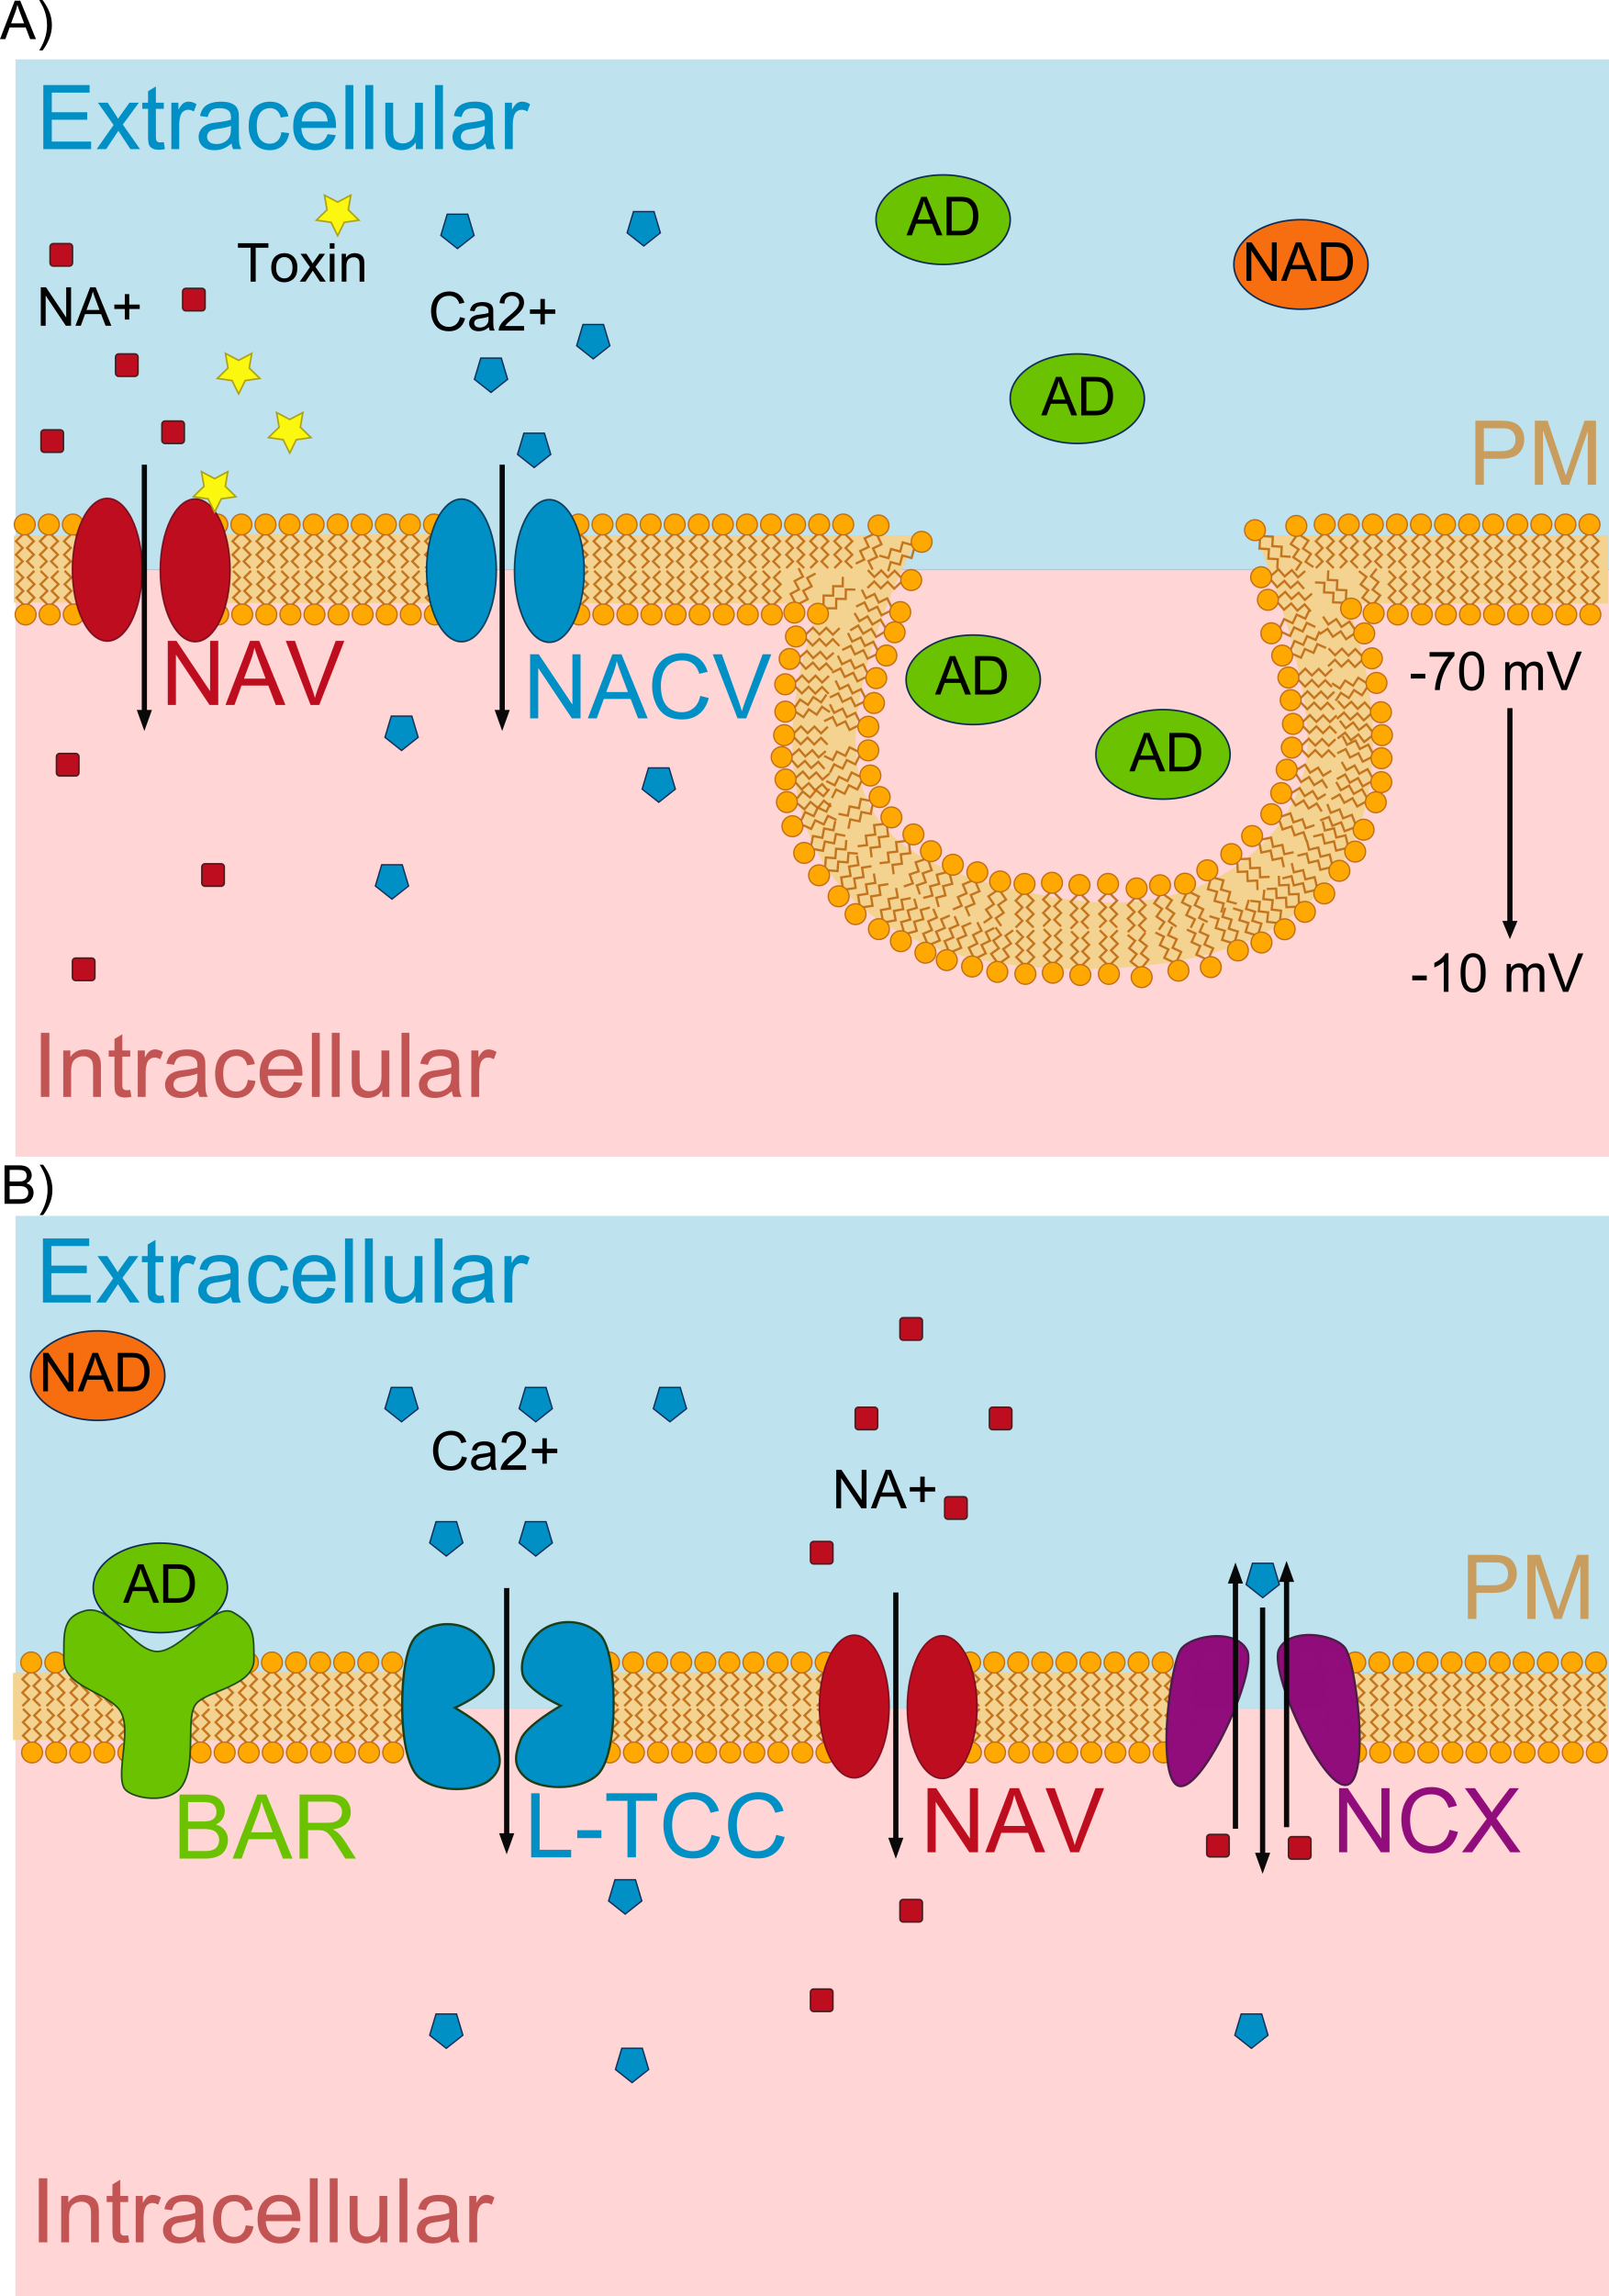
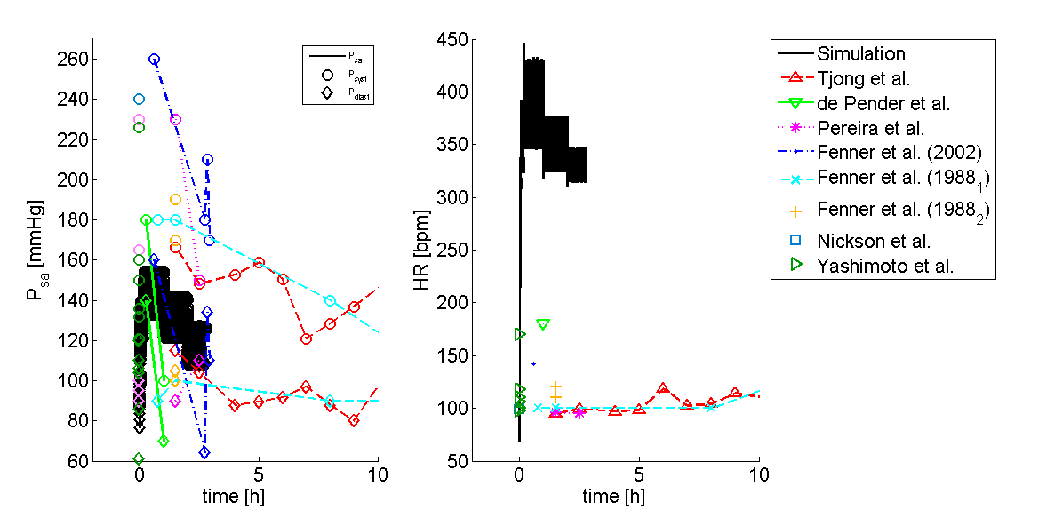
Mechanism of action of Jellyfish (Carukia barnesi) envenomation and its cardiovascular effects resulting in Irukandji syndrome
Karina Blei^{1*}, Stefan Willmann², Tobias Preusser^{1, 3}, Michael Block²
* k.blei@jacobs-university.de
(1) Jacobs University Bremen, School of Engineering and Science, Campus Ring 1, 28759 Bremen, Germany; (2) Bayer Technology Services GmbH, Technology Development, Enabling Technologies, Computational Systems Biology, Building 9115, 51368 Leverkusen, Germany; (3) Fraunhofer MEVIS, Universitätsallee 29, 28359 Bremen, Germany
Motivation
Results
Jellyfish stings have e very high incidence in northern Australia [1]. One of the most popular jellyfishes is Carukia barnesi (CB). These jellyfishes are small, difficult to see and extremely venomous. The sting causes Irukandji syndrome [2]. During envenomation a two phasic reaction takes place. This work is aimed to show the effects and investigate the mode of action (MoA) of CB venom on the cardiovascular system (CVS) in a newly developed physiologically based pharmacodynamic (PD) model for the CVS. Several hypotheses of toxin mode of actions are discussed. The Irukandji syndrome is a potentially lethal complex of clinical signs and symptoms
The literature research revealed different possible MoA of CB toxin, causing hypertension and hypotension. Generally a special dose dependent blood pressure pattern could be identified as is presented in Fig. 3. The initial phase is dependent on severity of envenomation and culminates in hypertension and tachycardia. In milder envenomation a prolonged hypertension can be found. In severe syndromic cases hypotension and pulmonary oedema occur, caused by life threatening cardiac failure. This hypotension is thought to be caused by direct damage of the toxin to the cardiomyocytes. Large knowledge gaps exist in the toxin’s MoA [2]. In literature different possible mechanisms are discussed. These are sympathetic activation, parasympathetic activation or inhibition, direct actions on the heart or the vasculature or a combination of these. Here a first attempt was made to model the Irukandji syndrome by increasing only the sympathetic activation over time. The resulting BP values increase comparable to literature values, but as obvious in Fig. 4 the simulated HR values are much higher than experimental human values.
Symptoms/ Definition
The Irukandji syndrome is defined as a potentially lethal complex of clinical signs and symptoms:
At least three of the following: severe low back pain; muscle cramps in all four limbs, the abdomen and chest; sweating; anxiety; restlessness; nausea; vomiting; headache
Possibly associated with: chest and abdominal pain, coughing, shooting spasms, and difficulty breathing; high blood pressure, paralysis, suffocation, pulmonary oedema, heart failure, or brain hemorrhage
Cause of death: intracranial hemorrhage, stroke
Methods
By the usage of PK-Sim® and MoBi® based on data for physiological factors determining the blood pressure (BP) and the circulation in human the physiologically based PD model was established [3]. CV relevant data of human CB envenoming have been collected for both phases [1, 4-8]. These data were used to establish a proof of concept study. Different possible mechanisms of action causing hypertension (sympathetic and vagal influence, even as changes in resistances) and hypotension (heart failure causing changes in elastance, resistance or pump function) will be investigated and simulated with the presented model. Finally both effects will be combined to simulate the full CV changes of jellyfish envenomation. Effects on the mean arterial blood pressure, the sympathetic and parasympathetic activity even as the dynamic changes in heart rate will be shown in detail. For the first tests only the sympathetic activity was increased in an AD/ NAD (see Fig. 1) comparable manner as described in [4,7].
Figure 1: Toxin’s Mechanism of Action. Figure 1A) shows the toxin’s mechanism of action at the sympathetic nerve terminal. The Toxin opens tetrodotoxin-sensitive prejunctional sodium channels (NAV). The Na+influx induces opening of N-type Ca2+ channels (NACV) and calcium (Ca2+) influx appears. The depolarization from -70 to -10 mV triggers the release of Adrenaline (AD) and Noradrenaline (NAD).
In Figure 1B) the mechanism of AD and NAD binding at the cardiomyocyte are shown. Beta-adrenergic receptor (BAR) stimulation increases the Ca2+ influx by L-type calcium channel (L-TCC) activation. Additionally the venom induces the influx of Na+ by the NAV channel, which is then changed by the Na+-Ca2+ exchanger (NCX) to an additional Ca2+ influx.
The resulting Ca2+ overload then causes tachycardia [9].
Figure 3: Exemplary pattern of BP changes after CB intoxication. Pattern of BP rising depends on the severity of envenomation. In lighter forms of intoxication (blue), the BP rises over time and comes back to a nearly “normal” BP pattern over time. In severe cases BP rises much faster, followed by a severe phase of hypotension. Hypertension is caused by sympathetic activation and tachycardia, while the hypotension phase is probably caused by cardiac failures caused by the toxins damage to the heart, stress induced cardiomyopathy, cardiotoxicity or refractory time of sympathicus [6,11].
A)
B)
-
F_{cs}
F_{es}
Elastance
Resistance
F_{ev}
Cardiac output CO
Blood Pressure (BP)
Heart period T (=1/HR)
Carotid sinus receptors
Sympathetic/ Vagal components
Vascular effects
Figure 4: BP and HR profile after sympathetic activation compared to human Irukandji data. Figure 4A) shows the BP pattern over time resulting from sympathetic activation. Circles indicate systolic values, diamonds indicate diastolic values. Black line is the simulation result, colored lines are identical to the colors from the right panel.
Figure 4B) depicts the HR pattern over time resulting from sympathetic activation. The black line indicates the simulation results, colored signs indicate the different observed data from literature [4, 12-17]. Data points at t=0 had no specific time given.
+
-
Conclusions/Outlook
+
+
-
After investigation of BP and HR profiles during Irukandji syndrome the resulting information was integrated into the physiologically based PD model of the CVS. The CVS model is able to represent the pharmacodynamics of CB toxin. Furthermore, the prediction of the BP, HR and activity of the autonomic nervous system are shown. The first results indicate that only sympathetic activation is not sufficient to describe the Irukandji syndrome. Our model indicates the inclusion of additional mechanisms like the activation of parasympathetic nerves or direct cardiac or vascular effects. These will be subject to further investigation.
+
+
References
-
[1] Huynh TT, 2003, Med J Aust.178(1):38-41.
[2] Tibballs J, 2012, Toxicon. 59(6):617-25.
[3] PAGE 22 (2013) Abstr 2825 [www.page- meeting.org/?abstract=2825]
[4] de Pender AM, 2006, J Travel Med.13(4):240-3.
[5] Ramasamy S, 2005 Toxicon. 45(3):321-7.
[6] Ramasamy S, 2005 Toxicol Lett.155(2):219-26.
[7] Winkel KD, 2005, Clin Exp Pharmacol Physiol. 32(9): 777-88.
[8] Li R, 2011, Toxicol Lett. 201(3):221-9.
[9] Andras C.D., 2011, Brain Res Bullet., 86:195-202.
[10] D’Angelo, 2005, ESAIM: Proceedings, 14:72-88.
[11] Karnad D.R., 1998, Heart, 79:485-489.
[12] Tiong K., 2009, Eur J of Echocard, 10:334-336.
[13] Pereira P., 2010, Clin Tox, 48:390-392.
[14] Fenner P.J., 1988, Med J Aust, 149:150-156.
[15] Fenner P.J., 2002, MJA, 177:362-363.
[16] Nickson C.P., 2009, Ann of Em Med, 54(3):395-403.
[17] Yashimoto C.M., 2002, Trans R Soc Trop Med Hyg, 96:300- 303.
Figure 2: Schematic representation of autonomic BP regulation. In case of very low BP the baroreceptors in the carotid sinus reduce firing (Fes). By this reduction, the sympathetic nerves increase firing (Fes), while vagal nerve reduces firing (Fev). The increased sympathetic firing increases elastance in heart chambers and resistance in the peripheral organs, even as a reduction in heart period . A reduced vagal activity reduces the heart period either. All these effects lead to increased cardiac output and thereby to increases blood pressure [10].

