Slide 1
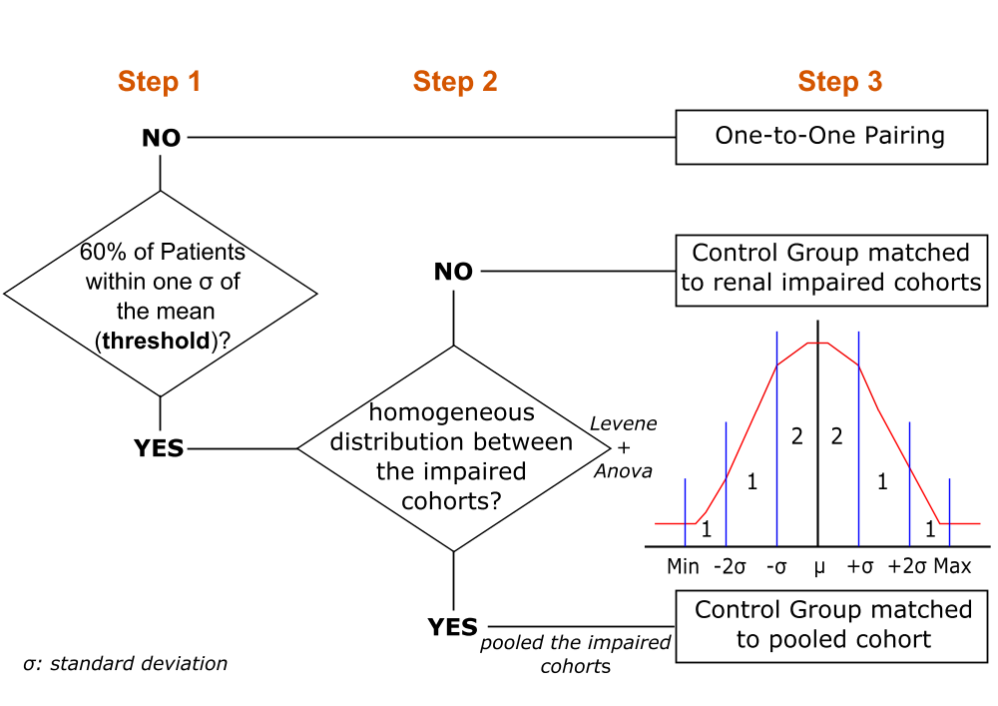
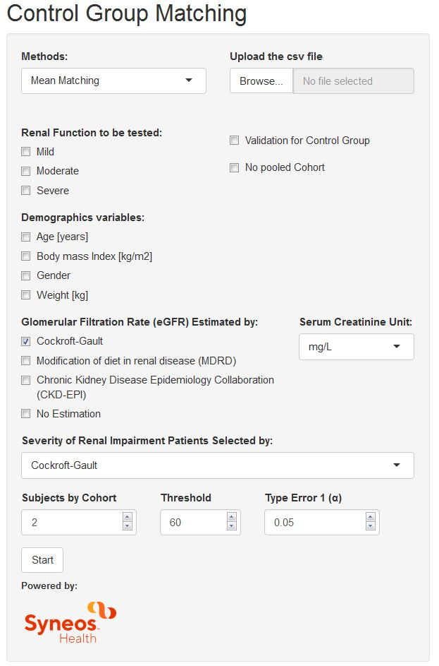
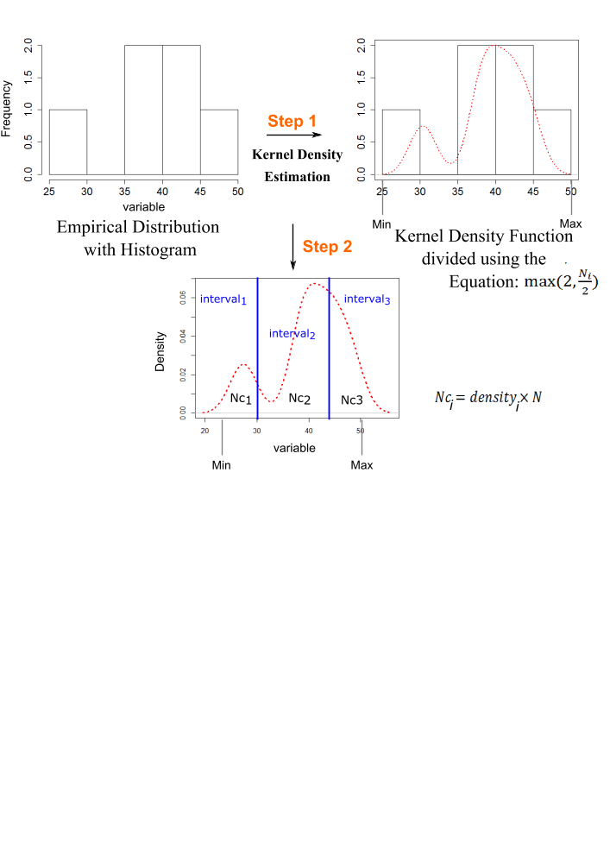
A new computational approach to match control subjects to renal impaired patients in pharmacokinetic studies
Guillaume Bonnefois⁽¹⁾, Raphaël Vlavonou⁽¹⁾, Pierre-Olivier Tremblay⁽¹⁾, Mario Tanguay^{(1,2)}
⁽¹⁾ Syneos Health Clinique, Québec, Canada, ⁽²⁾ Faculté de Pharmacie, Université de Montréal, Québec, Canada
Introduction
Most of drugs that are likely to be administered to patients with renal impairment (RI) should be investigated in this population:
  To assess the effects of this condition on the pharmacokinetics (PK)
  To provide appropriate dosing recommendations, if necessary.
These PK studies generally include the enrollment of control subjects who should match the renal patients
  In terms of age, gender, race or weight
However, there are no well-established “matching” procedures described in literature^{[1-4]}
Various strategies are applied for the matching procedure such as^{[5]}:
  One-to-one pairing: each patient of each category of renal impairment (e.g., mild, moderate and severe) would have his own control subject
  Mean matching: a single cohort of control subjects would match mean characteristics of the patients cohorts
Arbitrary limits were introduced to enable flexibility in the selection of control subjects:
  e.g. age ± 10 years, weight ± 20% …
One of the current challenges with the above methods is to ensure a similar distribution of demographics between patients and subjects cohorts
Objectives
Apply statistical concepts to propose a more robust and quantitative matching approach that would limit bias in the PK comparison
Develop a new computational platform to guide clinicians and to facilitate the selection of the control subjects
Mean Matching:
After the complete enrollment of RI patients, three-step process:
  Using statistical tests (Levene, Anova) and the empirical rule:
    proportion of patients within 1-, 2-, and 3 standard deviation of the mean corresponds to 68%, 95%, 99%, respectively
These two strategies were developed in R and then implemented into a web interface using R-Shiny^{[8,9]}
Results
Conclusion
An R-Shiny web-based application was developed through a user-friendly interface:
  Provides a step-by-step guide to clinicians for a flexible and robust selection of control subjects
  Requires further validation to confirm its practical application to renal impairment studies using real patient datasets
Selection of impaired cohorts:
  Mild
  Moderate
  Severe
Selection of variables amongst:
  Age
  BMI
  Gender
  Weight
Calculation of the eGFR using 3 equations:
  Cockroft-Gault
  MDRD
  CKD-EPI
Classification of patients according to eGFR
Validation of the selected control subjects in a second step
Material and Methods
One-to-One Pairing:
Based on an iterative two-step process:
  Estimated by the kernel density estimation^{[6,7]}
References
[1] Guidance for Industry “Pharmacokinetics in Patients with Impaired Renal Function”, FDA, 2010
https://www.fda.gov/downloads/drugs/guidances/ucm204959.pdf
[2] Guidance for Industry “Pharmacokinetics in Patients with Impaired Hepatic Function”, FDA, 2003 https://www.fda.gov/downloads/drugs/guidancecomplianceregulatoryinformation/guidances/ucm072123.pdf
[3] Guideline on the evaluation of the pharmacokinetics of medicinal products in patients with impaired hepatic function”, EMA, 2005
https://www.ema.europa.eu/en/documents/scientific-guideline/guideline-evaluation-pharmacokinetics-medicinal-products-patients-impaired-hepatic-function_en.pdf
[4] Guideline on the evaluation of the pharmacokinetics of medicinal products in patients with decreased renal function”, EMA, 2014. https://www.ema.europa.eu/en/documents/scientific-guideline/guideline-evaluation-pharmacokinetics-medicinal-products-patients-decreased-renal-function_en.pdf
[5] Paglialunga S et al. Expert Review of Clinical Pharmacology. 2017 10(3): 273–283
[6] Rosenblatt, M. (1956). The Annals of Mathematical Statistics. 27(3): 832–837
[7] Parzen, E. (1962). The Annals of Mathematical Statistics. 33(3): 1065–1076
[8] R Core Team (2018). R Foundation for Statistical Computing, Vienna, Austria
https://www.R-project.org/
[9] Chang W et al (2018). https://CRAN.R-project.org/package=shiny
guillaume.bonnefois@syneoshealth.com

